Slide 1
TDI Capstone Project
Assessing SBA data to predict loan defaults, optimization

Slide 2
Problem Statement
The SBA was established with the purpose of promoting and assisting businesses get credit in the market.
While there are success stories, there are also instances of businesses defaulting on their SBA loans.
Based on the data, can we derive insights on how to better target lending programs in order to maximize return on investment/minimize defaults?
Some initial explorations include:
What is the distribution of the time to default on a loan?
Is there a correlation on the loan amount and the charged-off amount?

Slide 3
Methods Used
SBA Dataset obtained from Kaggle
Dataset:
~ 46 MB
899164 rows, 27 columns
Data around borrower, loan amount, charged-off amount, guaranteed amount, dates
Python Libraries: Pandas, Matplotlib

Slide 4
Initial Analysis
Exploration of the columns contained in the dataset.
Determining number of columns, rows, data types
Cleaning of data:
Removal of rows with null data for columns of interest
Formatting of columns of interest so that calculations can be performed
Generation of plots
Calculation of statistics:
Mean
Standard deviation

Slide 5
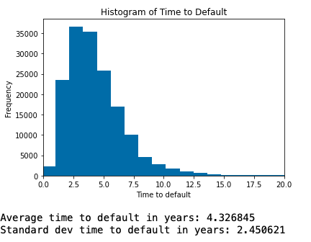
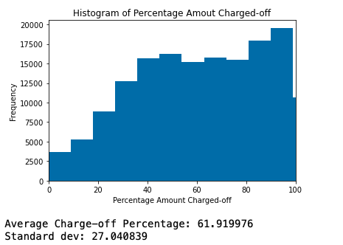
Plots Generated
https://github.com/alexvaldes001/TDI_Challenge/blob/main/Graph%202.ipynb
https://github.com/alexvaldes001/TDI_Challenge/blob/main/Graph%201.ipynb

Slide 6
Next Steps
Additional questions that could be answered:
Are is there any correlation between defaults and other external actions (e.g. recessions, massive industry changes)?
Optimize the loan amount and the jobs created/retained
Is a particular industry benefitting more of this program?
Is a particular geography benefitting more of the program?
Can the model be compared with other programs (e.g. PPP)?
Define metrics for success (e.g. default rate, charge-off %, total jobs/loan amount)

